Slide 1
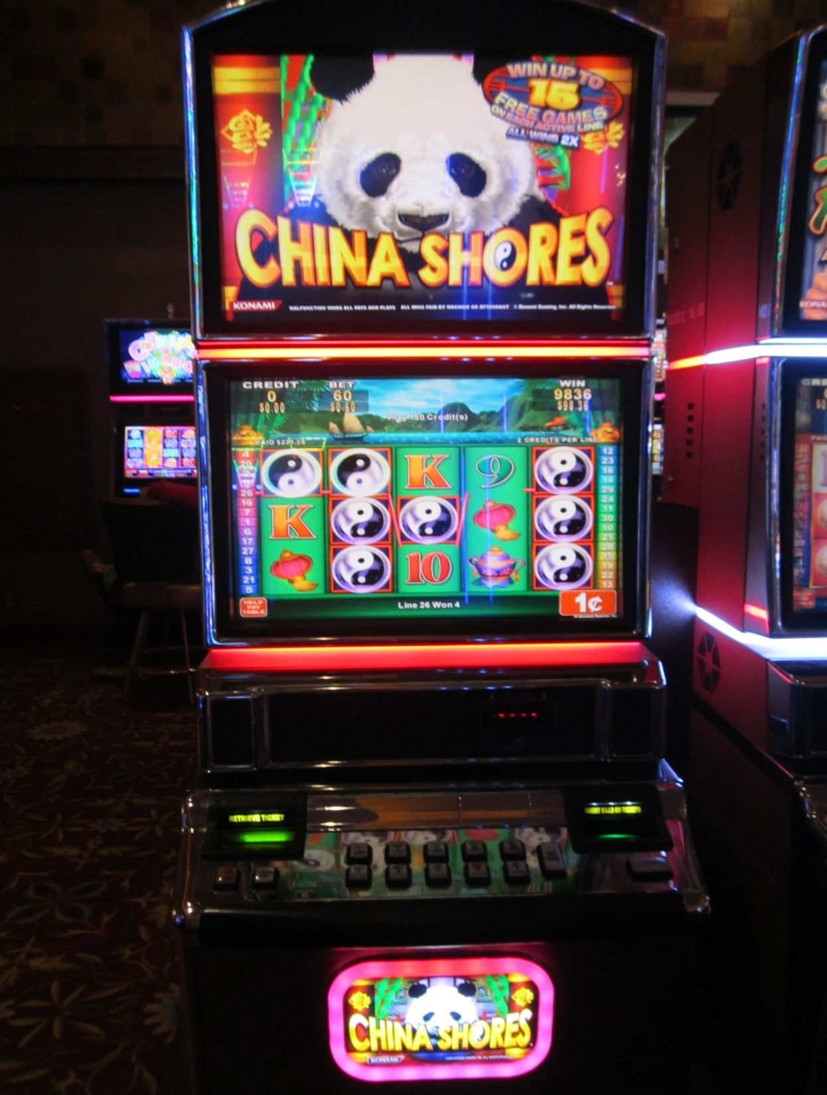
This is a full view of the China Shores video slot machine. When the game is in its normal play mode, the reels and symbols fill the game’s monitor, along with the meters that display wagering and payout activity.
The meters that display the credits available for wagering or cashing out, amount wagered and amount won are prominently displayed above the reels. All payouts, including jackpots, will display in the amount won meter. Also, the amount won is added to the credit meter to be available to wager or cash out.
Note there are no displays for player’s club account information. A player’s club card would have to be inserted, and after the applicable icons display and one is selected, the players club information screen is displayed, and available account transactions can be completed.

Slide 2
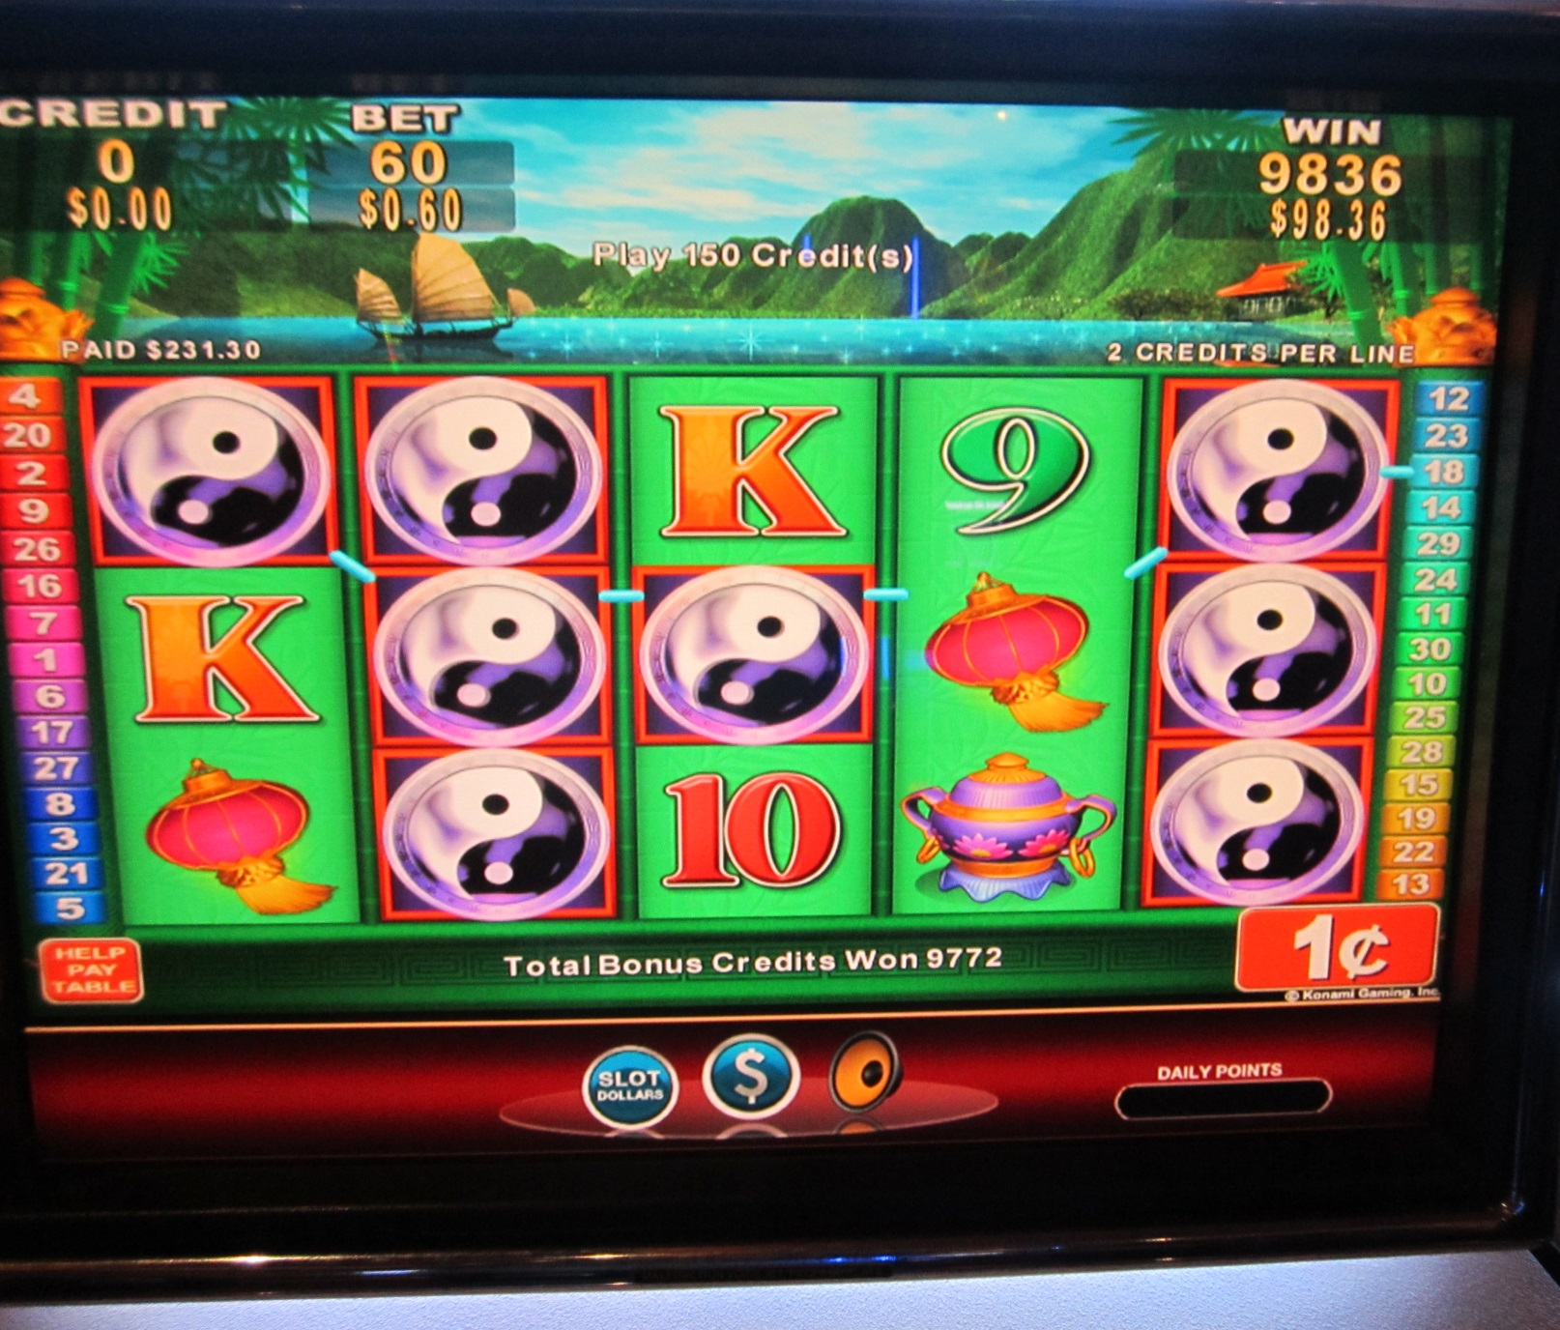
This is the machine’s monitor in play mode. The reels and symbols cover the screen. Also, slot credits available to wager, amount wagered and amount won (machine payouts) are displayed.
The player’s club account balance is not displayed, since that is not related to machine payouts and jackpots.
Players club members can access their account information by pressing one of these icons at the bottom of the screen.
The patron pressed the “Slot Dollars” icon to bring up the players club account information screen. Slot Dollars represent promotional slot credits provided by the casino to a player’s club member’s account as a marketing or promotional offer.

Slide 3
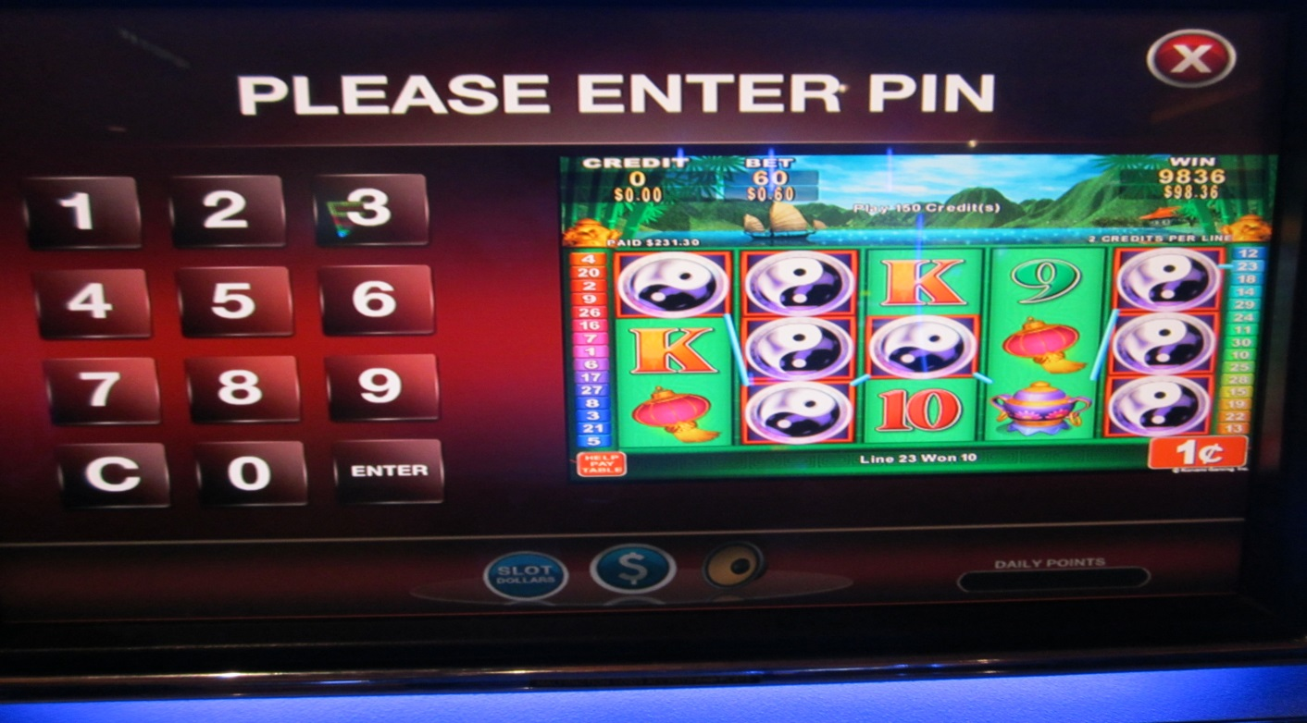
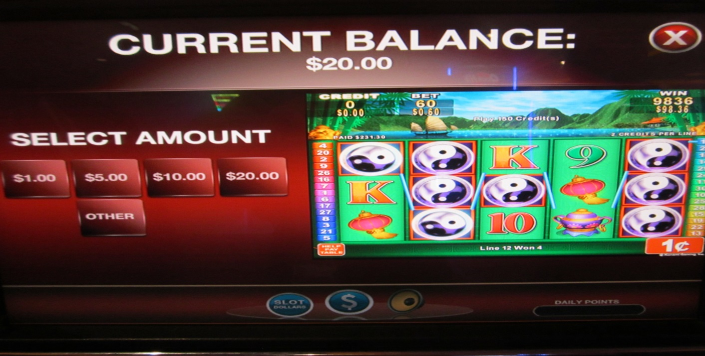
After pressing the “Slot Dollars” icon to access the player’s club account information screen, the screen for entering her PIN appeared, and she entered her PIN. At this point, no wager was made and no machine payout or jackpot occurred.
After entering her PIN, the screen changed, and the CURRENT BALANCE and SELECT AMOUNT option appeared. The CURRENT BALANCE relates to the Slot Dollars icon she pressed initially, and represents promotional credits added to a player’s club member’s account by the casino as a marketing or promotional offer. The SELECT AMOUNT option is to download available Slot Dollars (promotional credits) from the account.
The CURRENT BALANCE amount displayed is separate and unrelated to machine payouts and jackpots. The machines meters that display credits to be wagered, amount wagered and amount paid out (winnings) are displayed with the game’s reels and symbols.

Slide 4
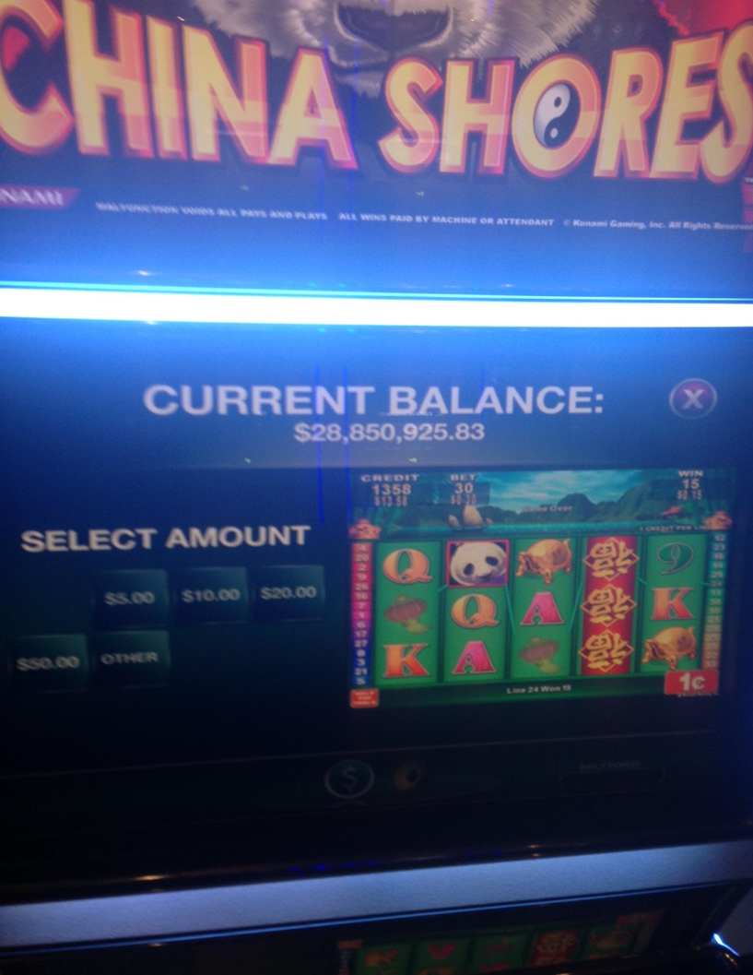
This is the actual photo of the screen that displayed the erroneous account balance. Subsequent to the last wager of 30 cents and machine payout of 15 cents, this patron had 1358 credits ($13.58). This is displayed on the meters just above the reels on the right side of the screen. The patron pressed an icon on the game to enter this screen, which is for viewing player’s club account information or performing account transactions, such as downloading available promotional credits. This screen displays player’s club account information, and indicates that the game is not in the play mode, where wagering occurs, and machine payouts and jackpots are processed.
The “CURRENT BALANCE” of $28,850,925.83 display is not related to a machine payout or jackpot. This balance displays promotional slot credits that can be downloaded and wagered, but not redeemed for cash. The promotional credits are provided by the casino to a patron’s account as a marketing or promotional offer, and is not in any way related to proceeds from a wager or any payout by the machine based on a winning combination.
The large and erroneous balance of $28,850,925.83 displayed one time, and when the player’s club card was reinserted, the account showed that nothing was available, since the patron had previously downloaded her available promotional dollars at a different machine. The erroneous amount that displayed was due to a software bug, and the vendor identified and is fixing that bug.

Slide 5
This screen displayed after the patron entered her PIN. The screen displayed is for viewing player’s club account information and performing account transactions. “CURRENT BALANCE” displays the dollar value of promotional credits, referred to as “Slot Dollars” in the patron’s player’s club account that can be downloaded and wagered, but not cashed out or redeemed for cash. These promotional credits are added to the patron’s account by the casino as a marketing or promotional offer. The “CURRENT BALANCE” is not a display of machine payouts or jackpots, and is not the result of a wager or machine payout. The “CURRENT BALANCE” is unrelated to machine payouts and jackpots.
When the game is in play mode, the reels would fill the screen, and these meters would be a larger display. The first meter displays the total credits available to wager or cash out. Machine payouts (winnings) would be added to this meter. As shown, there are 1358 credits or $13.58 available, as each credit is worth 1 cent. The second meter represents the last wager, which was 30 credits (cents). The last meter represents the amount won on the last wager, which is 15 credits (cents), and that was added to the credit (first) meter.
You cannot wager or play when the machine is in this mode. This is the screen to access account information and to conduct account transactions. The “SELECT AMOUNT” is for downloading promotional credits, which are typically provided by the casino for marketing purposes, such as a direct mail offer.

